Slide 1
Final Portfolio: Laser Tag Robot
Nicholas Barden, Jace Palmer, Kevin Sabbe, Kamen Schaefle, Jude Williams

Slide 2
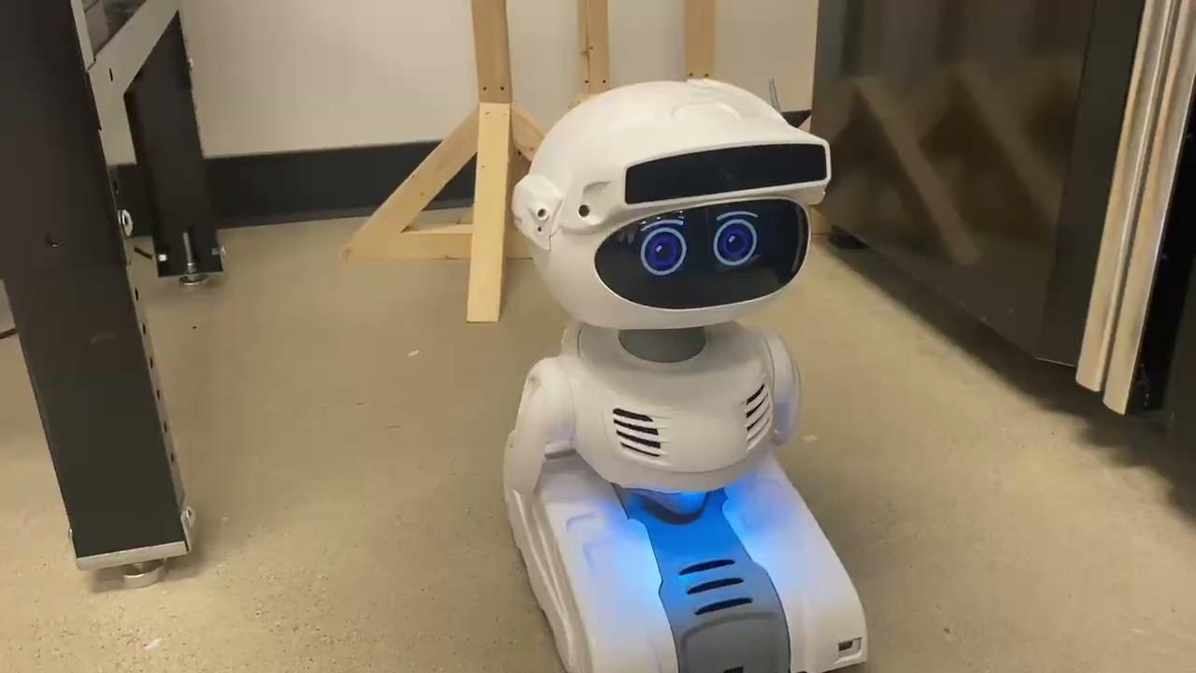
Using Misty's NLP to Replace Fast Food Workers
https://drive.google.com/file/d/1U8H8YPPnldZY_mCJ2yLq_BbrHh58_Vki/view?usp=sharing
For this project Misty’s built in NLP was used to create an interactive fast food ordering script. While this was successful, Misty’s NLP was extremely finicky and difficult to work with. For larger or more complex NLP projects I would recommend using another NPL software.

Slide 3
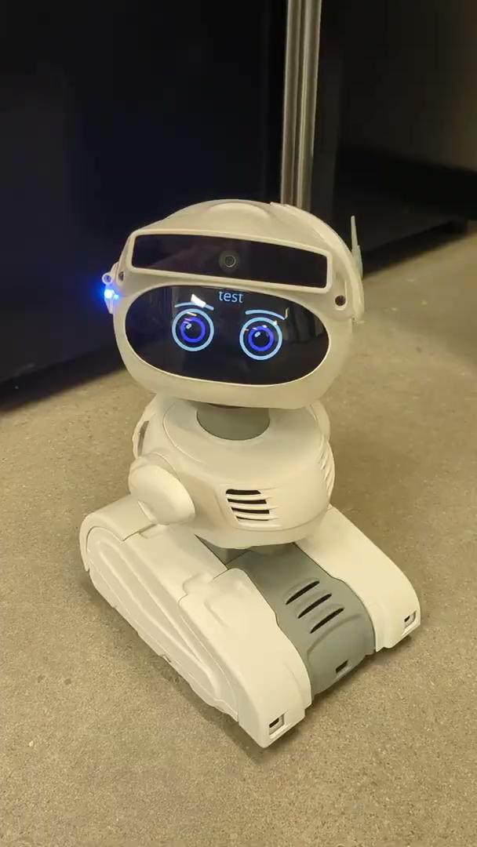
Using Misty to play simple games
The goal of this project was to recreate the game Rock, Paper, Scissors using the built in NLP commands, along with Misty’s bumper buttons. The result is a simple game involving speaking to Misty to initiate the game, and then using the bumper buttons to choose rock, paper, or scissors.
https://drive.google.com/file/d/1UB_Xpo5H0yK3TacRXaxgu881VmkUnlAg/view?usp=sharing

Slide 4
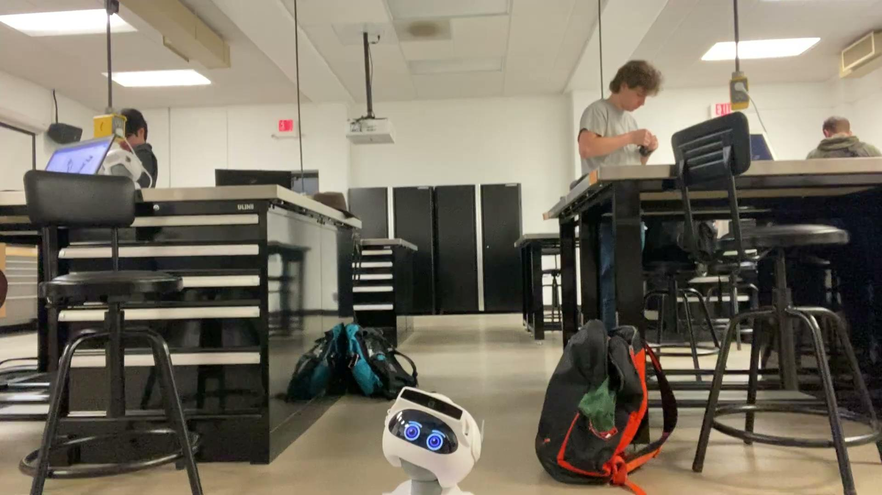
Interactive Game with Misty
https://drive.google.com/file/d/1k8Mmsw9CqAR_avagvmrS4KLE_iMT-uLC/view?usp=sharing
For this project a game was created using Misty’s built in human ID software. The goal of the game was to hit Misty’s sensors to score points but if Misty saw a person the game would end and she would then read out the points. This project was a success but Misty’s human ID took some calibrating to get it to actually recognize a human.

Slide 5
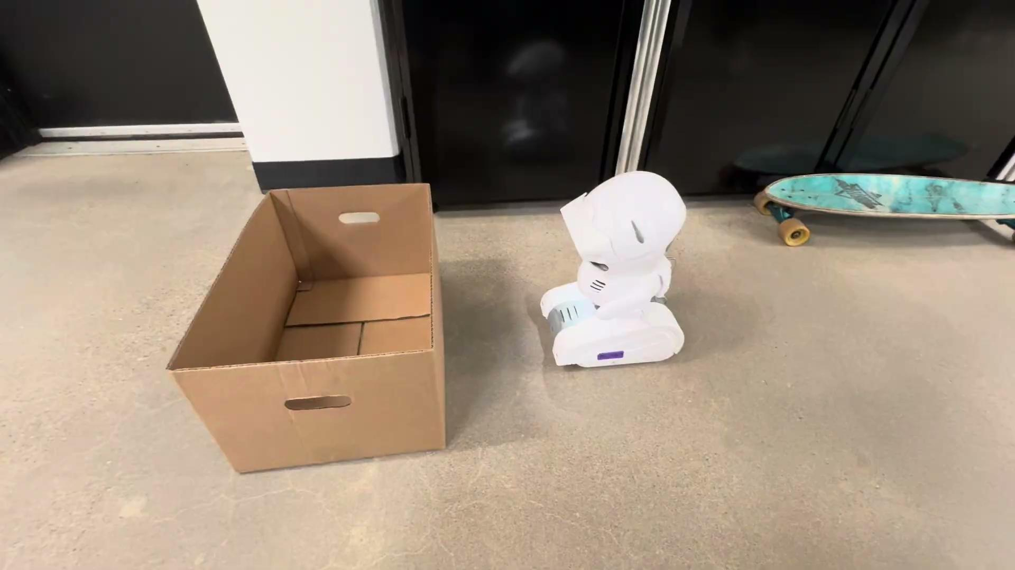
Angle Calculation using Time of Flight sensors on Misty
https://drive.google.com/file/d/1g2XCHO4tmrw2ouZPItFxAs-ykhm5L7Gb/view?usp=sharing
The goal of this project was to use the Time of Flight sensors so measure the angle of the wall in front of Misty. The program takes the sensor data from three different sensors on the front of Misty and calculates the slope of the wall in front of Misty.

Slide 6
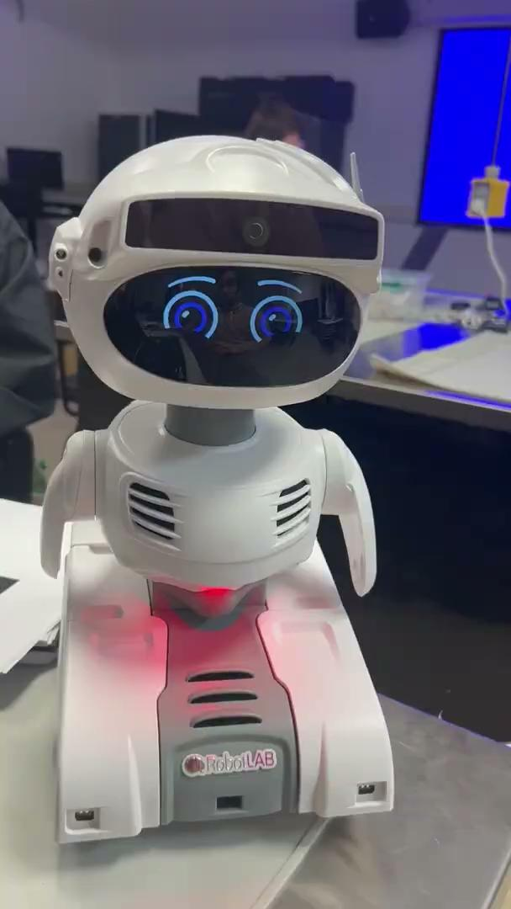
Misty conversations using locally run Large–Language-Model
Since Misty’s natural language processing was extremely unreliable, we made script that uses a locally run model from GPT4All to have Misty act as a personal assistant who answers questions. In the future the model could be trained to allow it to understand tasks Misty could physically do a bit better.
https://drive.google.com/file/d/1o9aUxr11KfK0U_UY0lBfk5nc8DfcjjBQ/view?usp=sharing

Slide 7
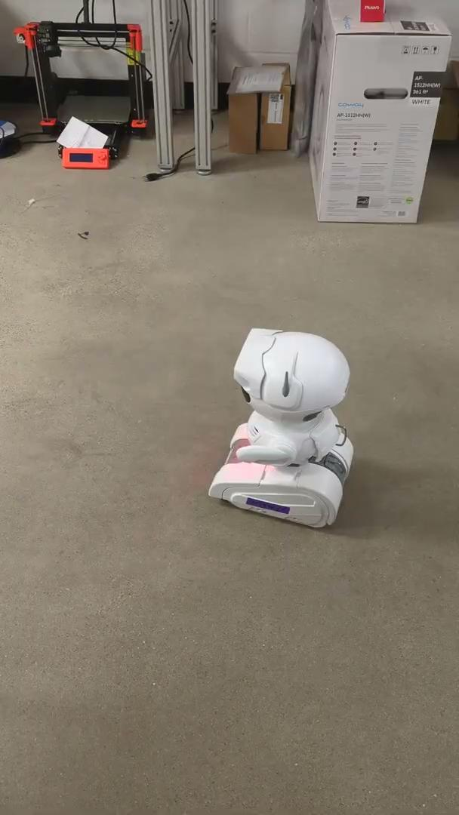
Using Misty to detect and travel towards AR tags
The goal of this project was create a pathfinding system based around AR tags. Misty would identify a tag, ensure it’s the next in order, and then travel towards it, attempting to correct her direction towards the tag, and trying to find the tag again if it falls out of frame. Ultimately allowed misty to do round trip “patrols” and point to point trips around the class.
https://drive.google.com/file/d/1VokRDYXzLolhK7laHb1UfbexnM06v-LA/view?usp=sharing

Slide 8
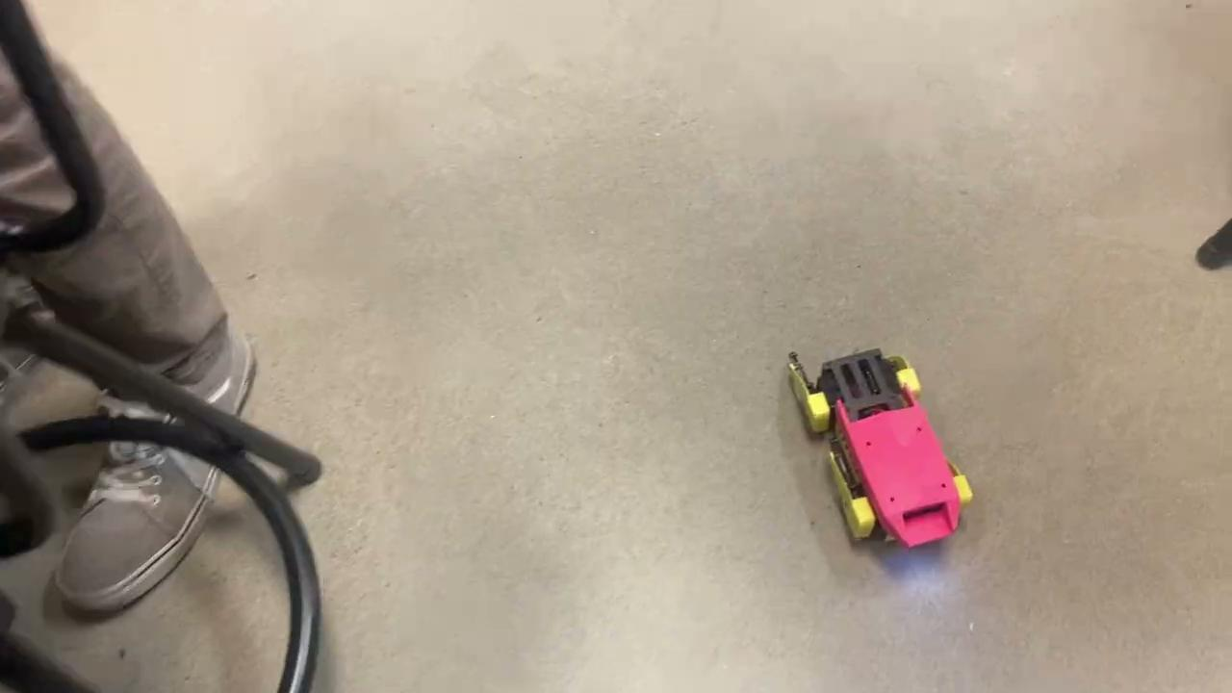
Creating a Smoother Turning Movement for Mini Pupper
https://drive.google.com/file/d/1gVVyg4jtFG4HuFIiXLILIS-jimRgrTaR/view?usp=sharing
The goal of this project was to improve Mini Pupper’s movement to be a bit smoother than the default so there would be less vibration. The goal was a much slower movement, however Mini Pupper will fall over with slow movement patterns. The result is the slowest Mini pupper can rotate without falling over.

Slide 9
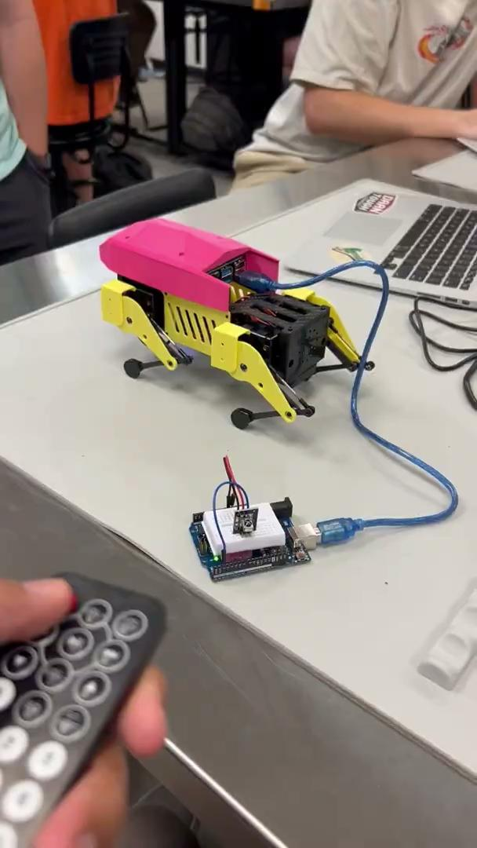
Communicating to MiniPupper through IR and Arduino
For the MiniPupper to be able to receive IR signals to determine when it was “Hit”, we tested this first by using an IR remote to send commands to an IR Receiver on an Arduino. We also deciphered each of the IR signals so that they can be tied to individual controls that move the robot as shown in the video.
https://drive.google.com/file/d/1DB9t2M_c8wWk16YGTDtL6sQyMWencoxQ/view?usp=sharing

Slide 10
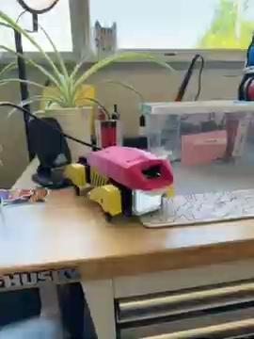
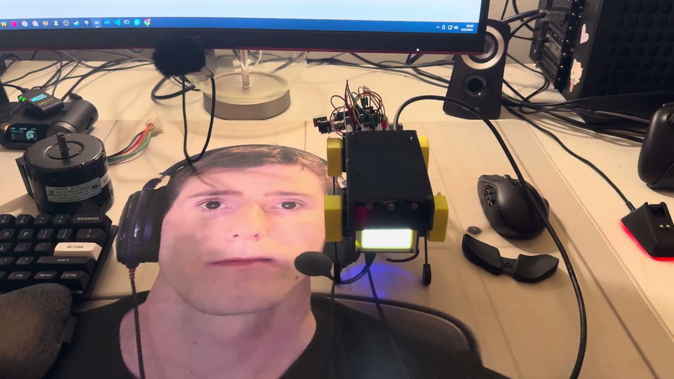
Custom Mini Pupper Movement Commands and Actuation
https://drive.google.com/file/d/1mYgseM59Txl8qj4ofU9TjVMPHof1khF7/view?usp=sharing
To ensure controlling the legs on the Mini Pupper is consistent, we created custom leg commands using custom logic. This allows us to create our own walk patterns, interpolate between stances, and have complete control over how the robot moves.

Slide 11
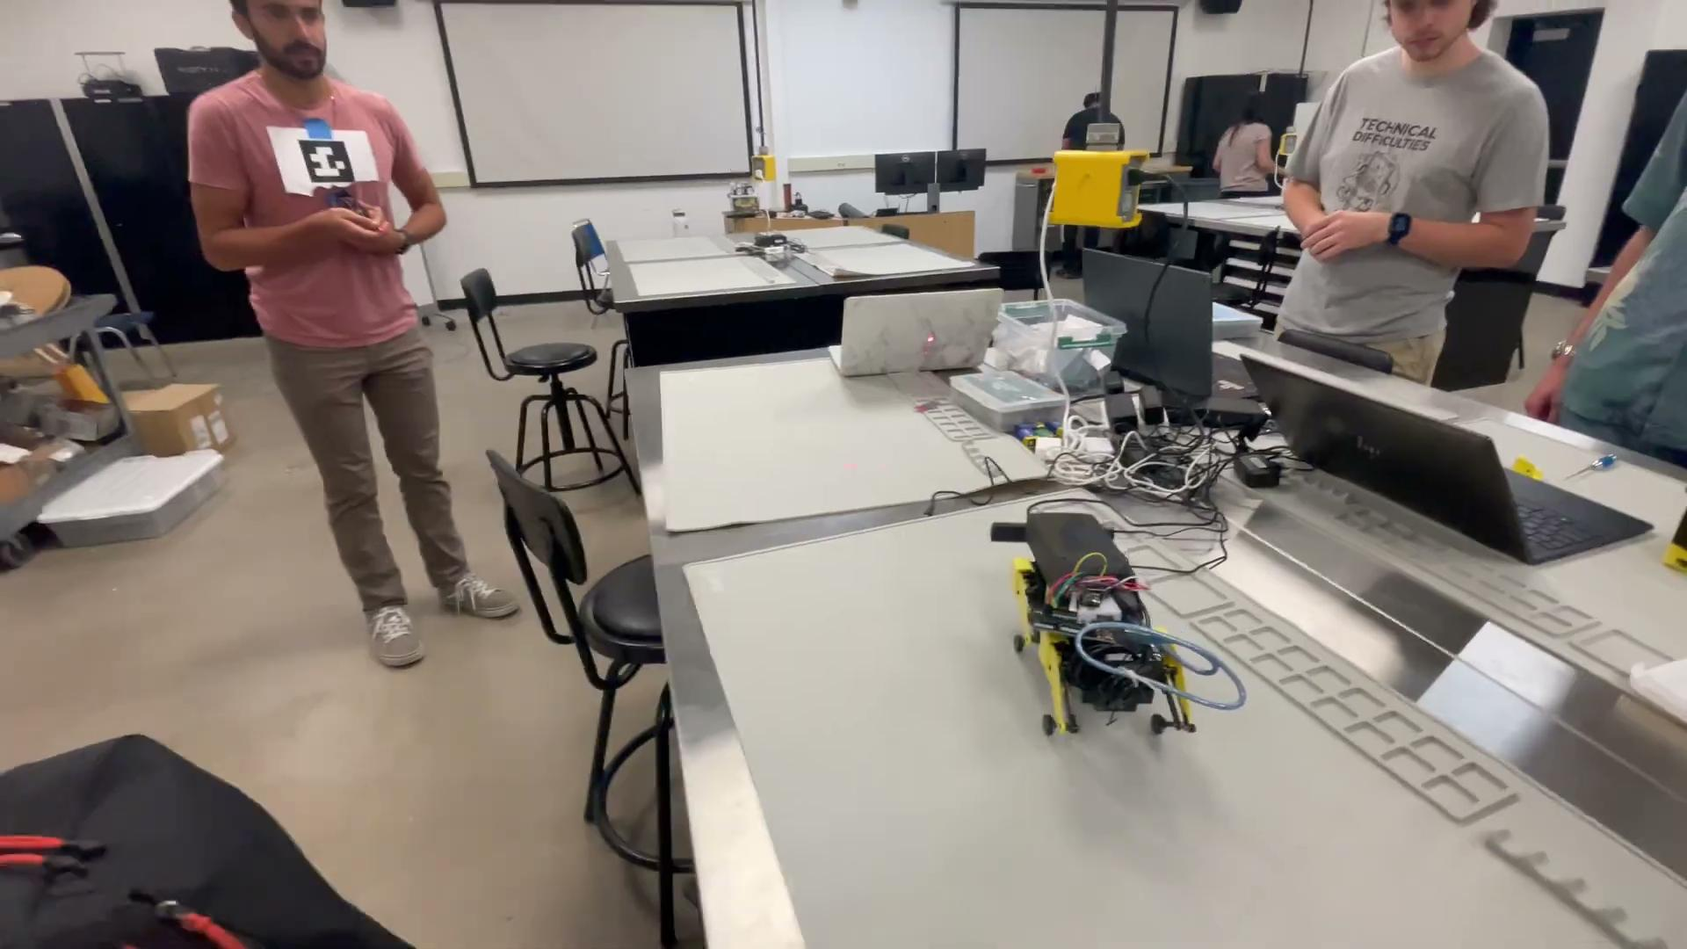
Mini Pupper Laser Tag
https://drive.google.com/file/d/1Ff6xcSoTxEV7uzhjha5pljZl4Dnv512x/view?usp=sharing
For our team’s final project we decided to make mini puper play laser tag with a human. The Mini Pupper turns and looks for an AR logo. One the pupper locates the AR tag it stops moving and then aims by twisting its body to the correct position and fires the laser.

Slide 12
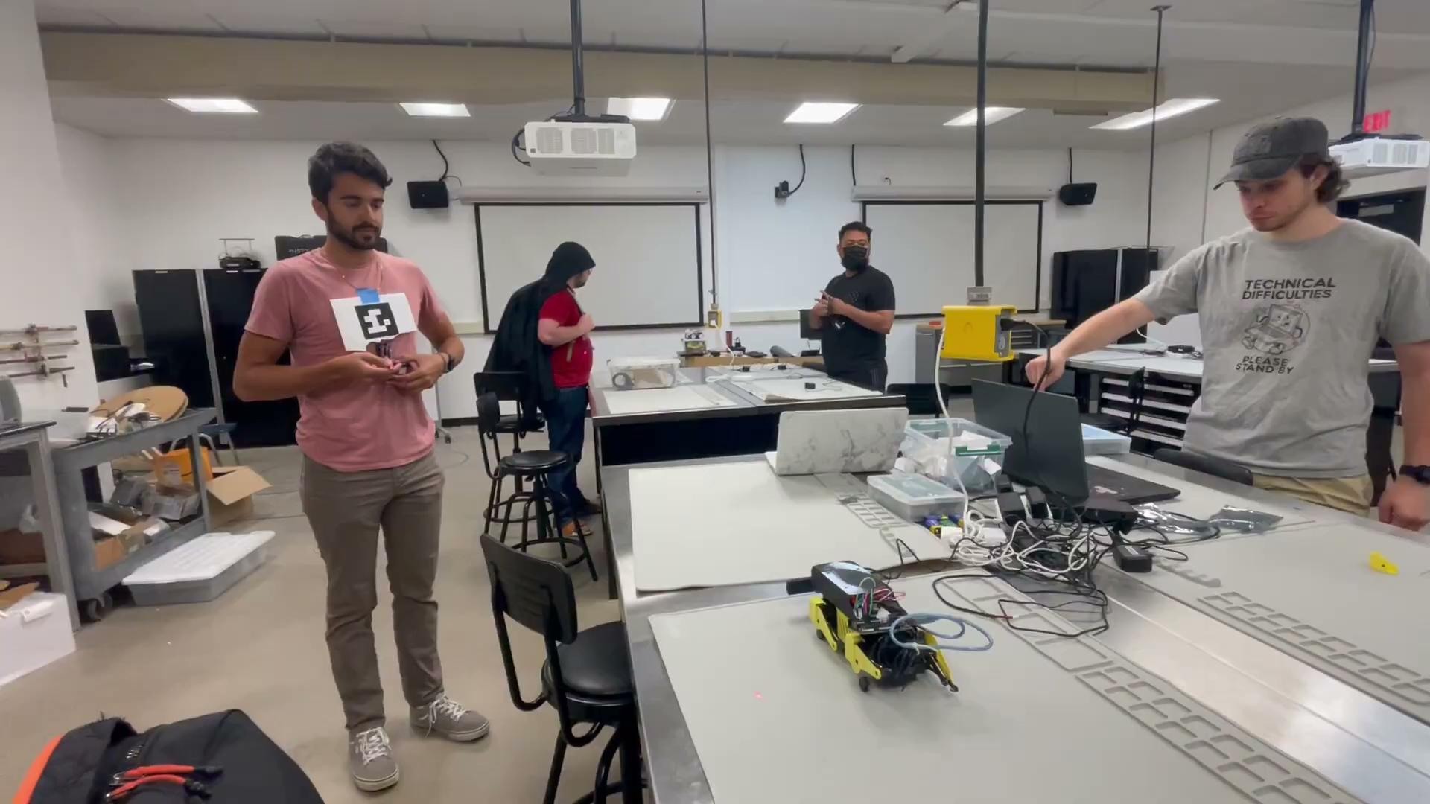
*Bonus* Objective
Have the robot defend from intruders through “tagging” the eyes
https://drive.google.com/file/d/1ibzHX_EvRzkNelhkHj7ZjzvHPSQZTaa3/view?usp=sharing

Slide 13
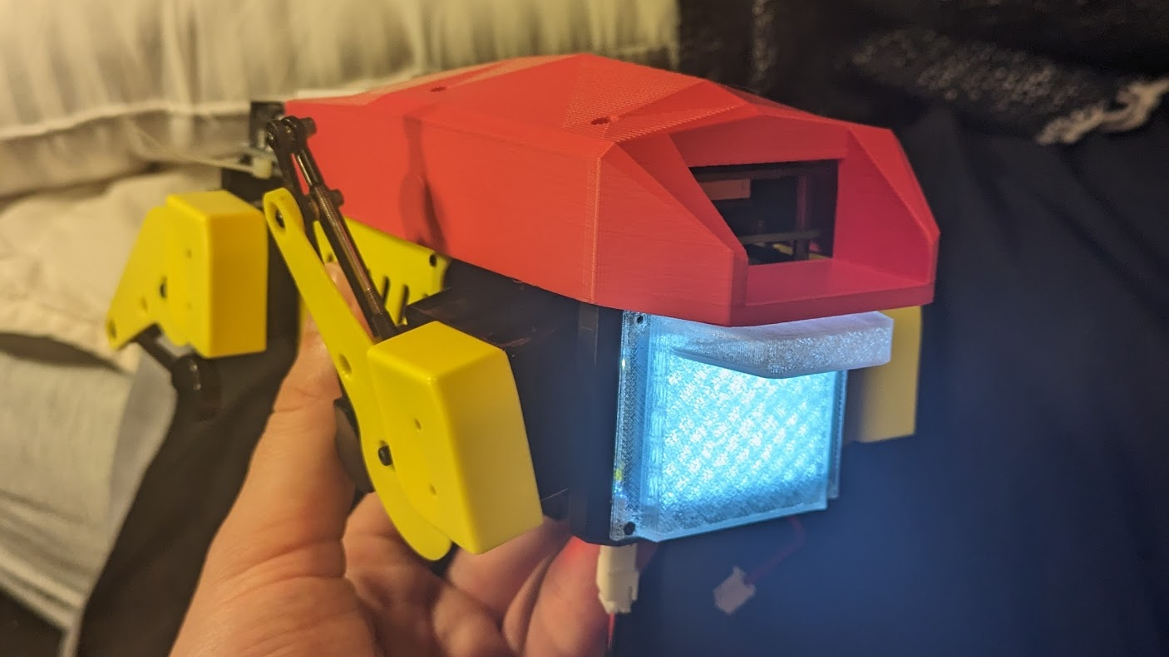
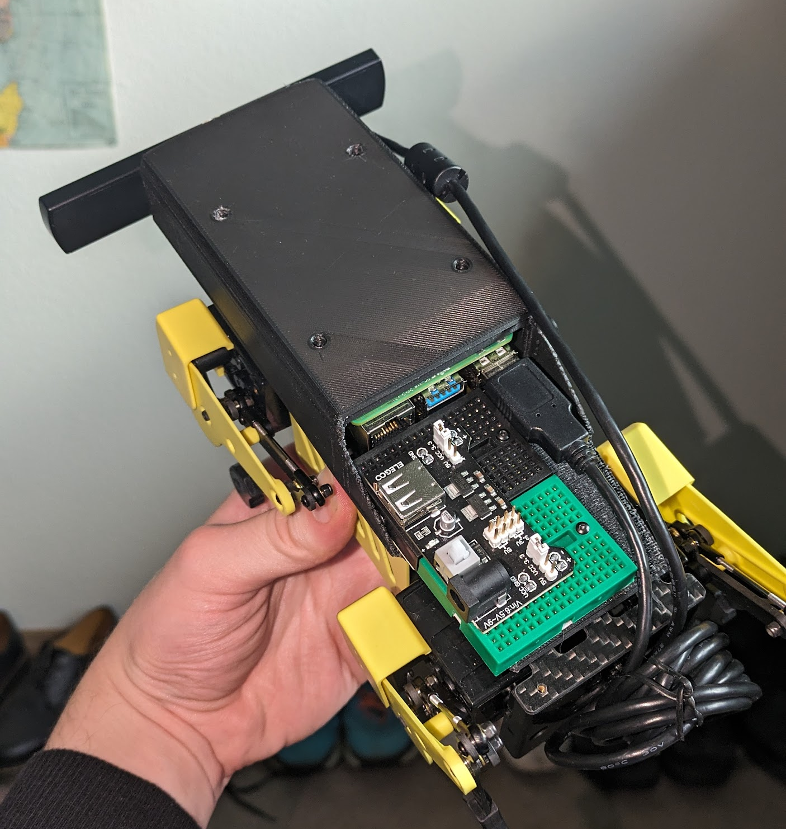
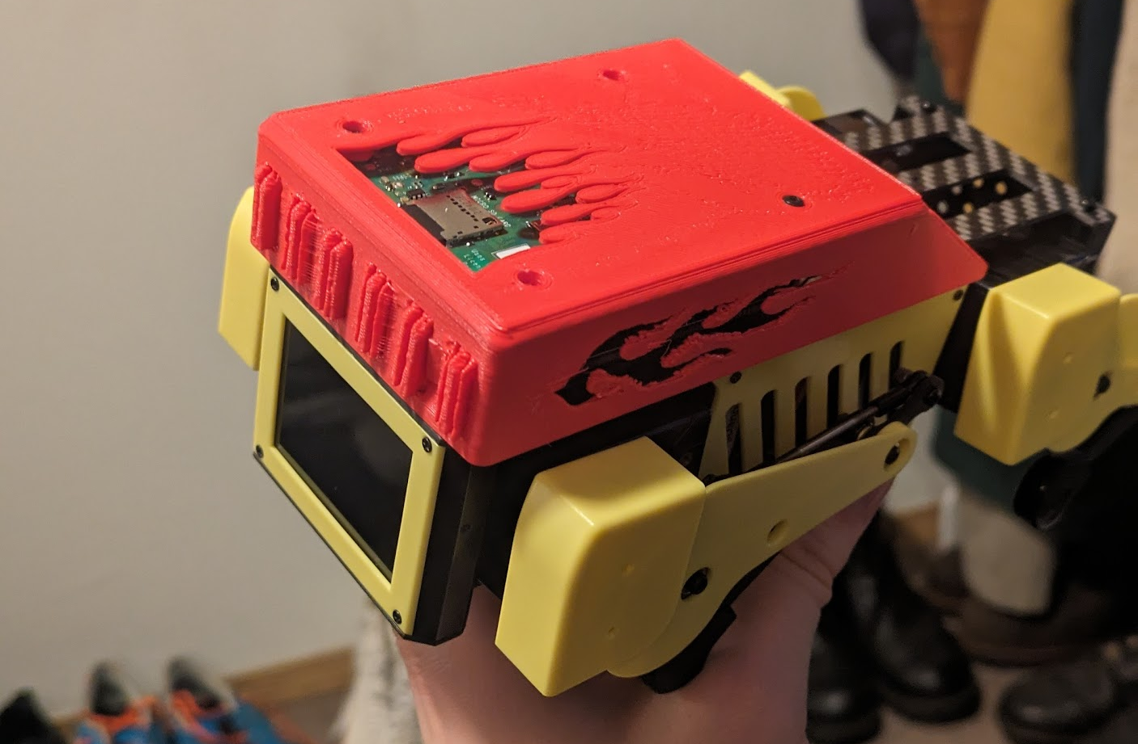
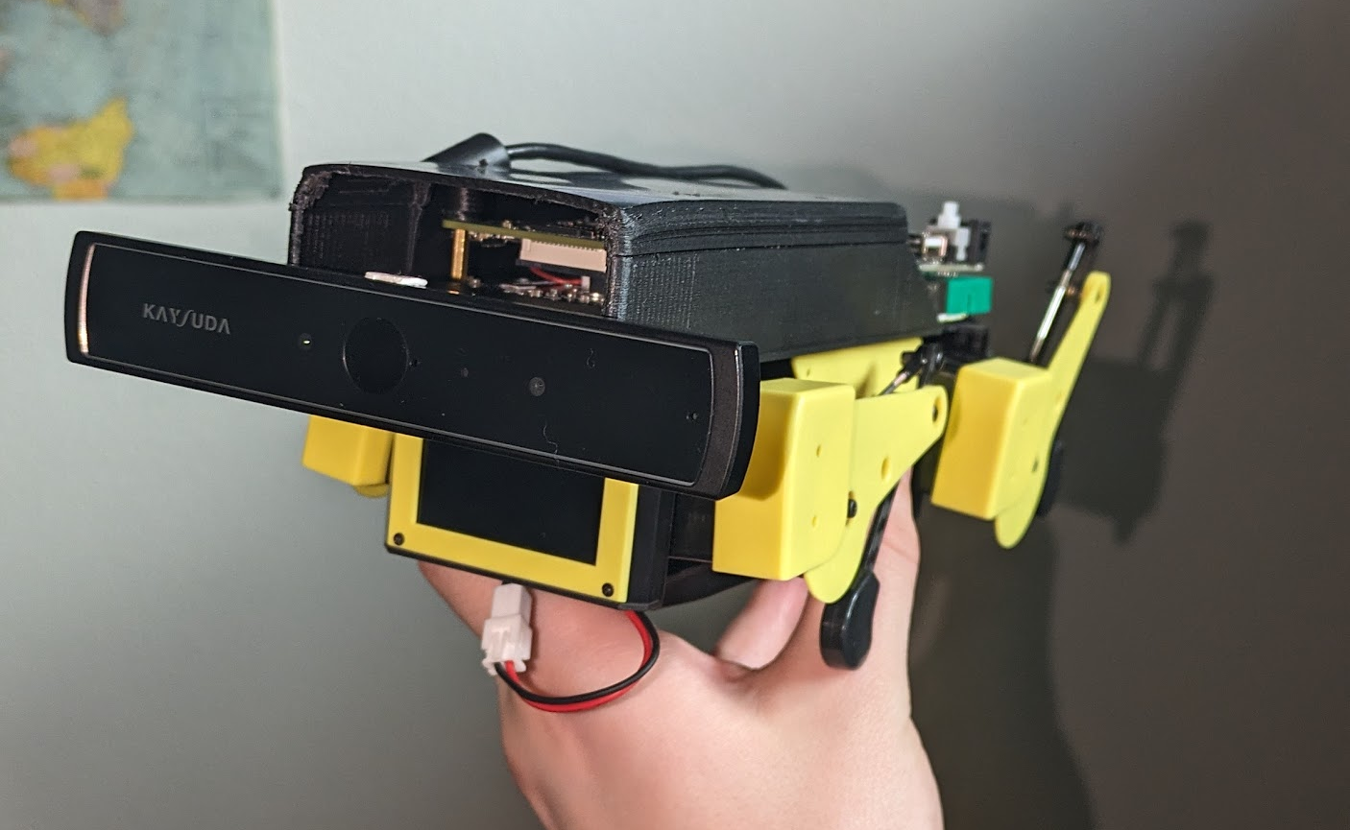
*Bonus* Objective
Experimental
“Beetle” shell and front screen diffuser.
3D Printed Shell Designs
Final Shell: Designed to accommodate - camera
- IR/Visible laser beam array
- Arduino
- Breadboard
- IR laser receiver
Experimental
“Hot Dog” shell for racing.

